Slide 1
Aachen Dynamometer Test Motor/Generator Specification
Bill Erdman
06/06/2014

Slide 2
Draft Specification and Definition of Dynamometer Test Generator
Assumptions
Test generator principally serves to support hydraulic testing.
No custom generator designs, such as we have discussed in the past will be included, i.e. high slip, low in-rush, special environmental protections, or other considerations.
Selection of a catalogue IEC motor is acceptable, it will be used as a generator*
* An approach used regularly in the wind energy industry

Slide 3
Catalogue Motor/Generator
Motor/Generator Available form ABB, Siemens, Loher, Leroy-Somer
Parameter | Value
Continuous Rated kW Class F Insulation/Class B Rise | 250 kW
ABB Model # | M3BP 355 SMA
Speed at Rated Torque | 1479 (Motoring) 1519 (Generating)
Efficiency ⁽²⁾ (IEC 60034-2-1; 2007) | 100% Load: 95.9% 75% Load: 95.9% 50% Load: 95.4%
Power Factor @ Full Load | 0.85
Rated Current | 426 Amps
Starting Current (Cross the Line) | 7.6 X Rated Current
Rated Torque | 1604 Nm
Pull Out Torque | 2.5 X Rated Torque
Moment of Inertia | 5.9 kgm^2
Weight | 1610
Sound Pressure Level | 74 db
Voltage | 400 V/50 Hz./ 3-Phase
Enclosure Foot Mounted ⁽¹⁾ | IP 55
Flange Mount Available Upon Request
Expect Slightly Lower Efficiency in Generation

Slide 4
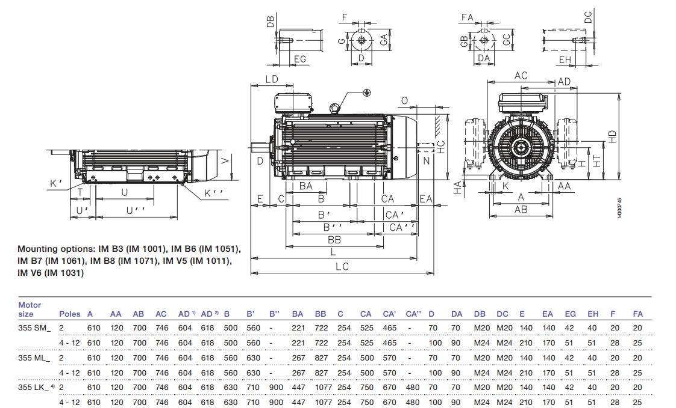
Foot Mount Generator Dimensions

Slide 5
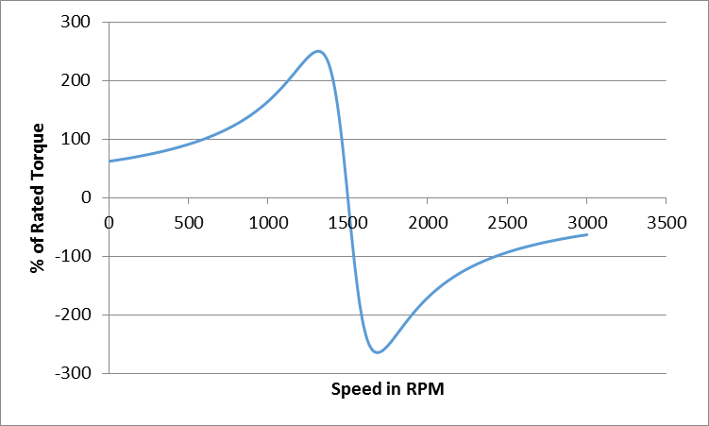
Quasi-Steady State Torque Speed Characteristics ⁽¹⁾ Stator and Rotor Taken at 125 Deg. C.
100% Torque @ 1519 RPM
248% Torque @ 1320 RPM
265% Torque @ 1680 RPM
100% Torque @ 1479 RPM
Region of Operation
Motoring
Generating
(1) Full Dynamic Model Available on Request

